Slide 1
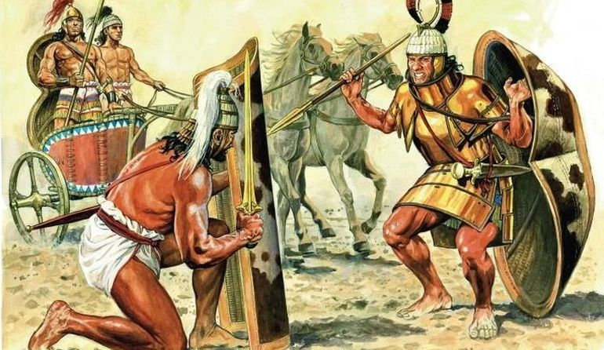
The Myceneans
Goal/s:
Analyze evidence of the Mycenean civilization
Week 8 Lesson 3
Ms Barrie

Slide 2
PEI – People, events, ideas
What PEOPLE do you know are involved in the Mycenaean civilisation?
What EVENTS do you know are involved in the Mycenaean civilisation?
What IDEAS do you know are involved in the Mycenaean civilisation?

Slide 3
People | Events | Ideas

Slide 4
Fortified Palaces, The Lion Gate

Slide 5
Lions Gate: the only entrance still standing to the palace, therefore people of wealth would have gone through that gate, as well as traders and the general populace who would have been using the gate to get to the market which would have been held in the palace grounds. Having a fortified gate shows a difference to the society from the Minoan, which had no gate, so a change to military and society thoughts. Significant people – Agamemnon, and the ideas or beginning of the Trojan war, including Helen, Menelaus, Paris etc.

Slide 6
The Lions Gate
One of the standing areas of Mycenae still standing
Shows that military has become a key component of society due to the walls and gates for fortification
The gate is referred to as the Lion’s Gate, as there were 2 lions at the top of the gate which will also refer to the Mycenaean’s as a strong and powerful society.
Don’t know if this activity had any political, social or religious importance BUT there must have been a reason why gates were needed to be used.
Site has been impacted by Heinrich Schliemann and his views on the Trojan war, which means that we may not have a full knowledge on the Mycenaean’s because he was so influential in the excavations and re-telling of the ‘story’ of the society.

Slide 7
Minoan Vs. Mycenean
Mycenae is on land, Minoans next to water
Mycenaeans had HUGE walls
Minoans used sea a barrier or “wall”
Minoans used a naval fleet to defend palaces (and merchant fleets)

Slide 8
The Megaron

Slide 9
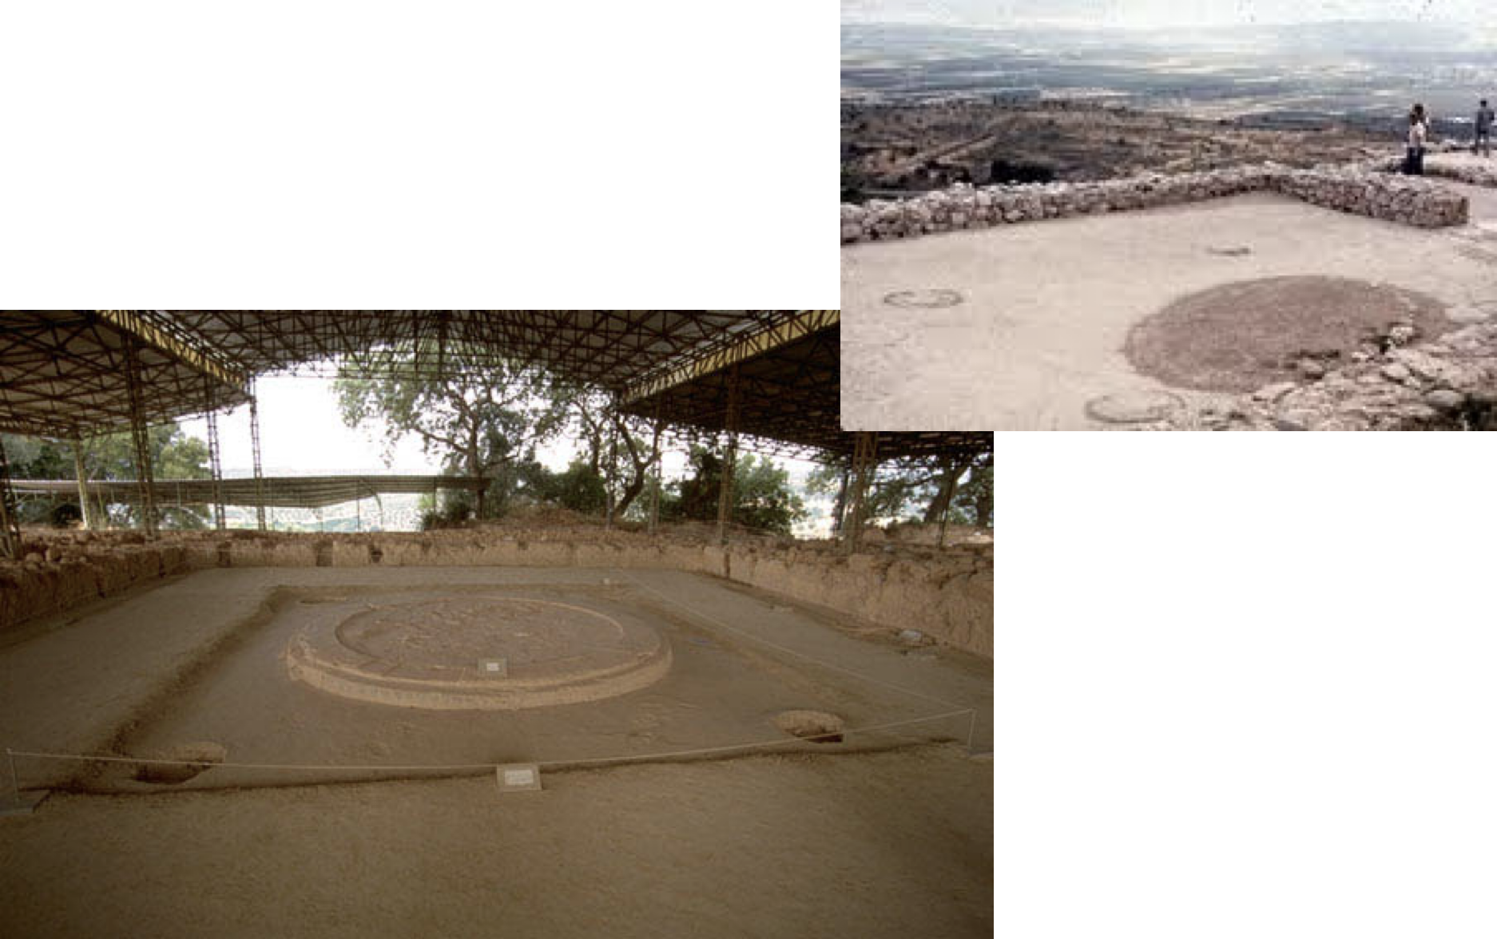
Megaron Remains

Slide 10

Outside the Megaron
Residential quarters
Storage (wine, olive oil, grain, textiles, metals, war equipment and supplies)

Slide 11
Grave Circle A

Slide 12
Grave Circle A - Artefacts

Slide 13
Death Masks
A series of golden funerary masks found on buried bodies within a burial site titled Grave Circle A,
Seven discovered masks in total, found with the burials of six adult males and one male child.
There were no women who had masks.
Discovered by Heinrich Schliemann during his 1876 excavation of Mycenae.
There is also a death mask found in Grave Circle B, but it differs from the Circle A masks both in material, as it is made from electrum, and placement, as it was placed in a container besides an entombed body, rather than being placed upon the deceased.
The relative scarcity of death masks in Grave Circle B indicate that the buried dead were of lesser wealth or status, rather than Grave Circle A with an abundance of material made from valuable materials, such as the Death masks.

Slide 14
Death Masks
Likely direct representations of the deceased
Symbolizing a continuation of the dead's identity in death, similar to funerary statues and incisions, immortalizing an idealized depiction of the deceased
The masks were not found on all the bodies inside the grave site, indicating that those who had them were of special status, and that the golden masks are a display of power
A part of daily life in ancient Greece.
Form of religious/social practice - show respect to deceased
Death masks were a common feature as they were one way for the living to be able to remember and celebrate the life of the deceased – there were sometimes festivities after the funeral (we would now refer to it as a wake).
Mask of Agamemnon
No other king from this time is known and Agamemnon is significant as he is connected to the Trojan war and the Iliad written by Homer.

Slide 15
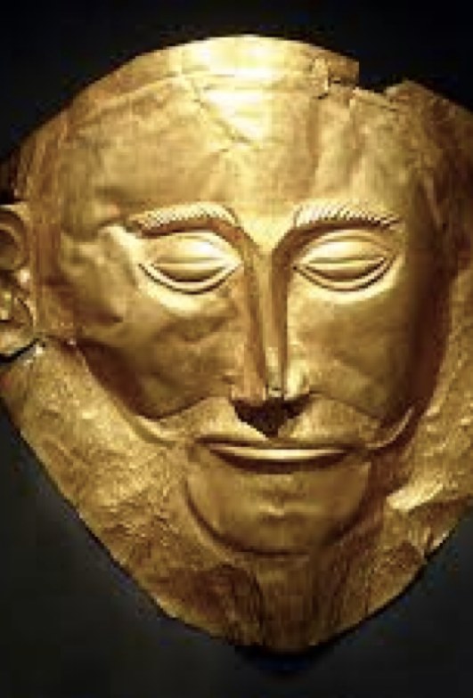
ISSUE!
Heinrich Schliemann and the fact that the mask might be a fake.

Slide 16
What does this evidence tell you about the Mycenaeans?
They were sophisticated society which had developed from the Minoans in different ways and that they were more of a military based society (fortified wars and death masks) and that mythology is beginning to play a role in society.

Slide 17
ACTIVITY – Strengths and Weaknesses
 | Strengths in teaching us about Mycenaeans | Weaknesses in teaching us about Mycenaeans
Fortified Palaces
Death Masks

Slide 18
Fortified Palaces
No knowledge about the majority of this site, and this is just one area of the palace site. There is no knowledge on why this palace is fortified or who they may have had to fortify their palace against. There is also no information as to what else the gate was used for, was it for a market, identification purpose or military.
Basic insight into Mycenaeans but not all aspects of SPERM

Slide 19
Death Masks - Agamemnon
Strength is that it is an artefact from the period. It shows the skill and detail of the Mycenaean metal workers. As death masks were a key aspect of daily or everyday life and religion it is a strong source to indicate some death practices and how the deceased were remembered. It also brings a link from the source and Agamemnon
Weakness is that the source is believed by some historians to be a fake, so its provenance is disputed. Some believe that Schliemann faked the mask to justify his site works and to connect to his site in ‘Troy’ of the ancient site of the battle of Troy. Also, as it is a death mask it tells us a little about society but not much else.
Basic insight into Mycenaeans but not all aspects of SPERM

